Slide 1



BIOPHOTOVOLTAIC SYSTEM
Team Members :-
Neha Mahajan (Team leader)
Tejas Bhavsar
Mentor :- Sagar Yadhav
College Name - Dr. D. Y. Patil School of Science and Technology
Notes:
Let's delve deeper into the exciting world of sustainability and AI.
In this chapter, we'll explore how artificial intelligence can be a powerful tool for addressing environmental challenges and promoting sustainable practices. We'll discuss specific applications of AI in various sectors and analyze its potential to drive positive change.
Get ready to discover the innovative ways AI is contributing to a more sustainable future!

Slide 2

Project Objectives
Project Goals and Vision
Problem Statement
Project Overview – Introduction
Motivation
End Users
Wow Factor in Project
Modelling/Block Diagram/Flow of Project
Result/outcomes
Conclusion
Reference
Future Perspective
Notes:
Let's outline what you'll learn in this presentation.
By the end, you'll be able to:
Understand how AI helps solve problems like climate change, resource depletion, and biodiversity loss.
Identify key AI uses in energy efficiency, waste management, and climate change.
Analyze AI's role in sustainable agriculture and cities.
Evaluate AI's use in environmental monitoring using satellites, real-time data, and predictions.
Apply AI strategies in logistics and transportation to make them more sustainable.
Get ready to discover how AI can help create a greener future!

Slide 3

Project Goals and Vision
To design a cost-efficient alternative to silicon solar panels using natural fruit electrolytes.
To develop a real-time intelligent system that recommends the best fruit for electricity generation based on the user’s city weather.
To calculate power output, efficiency, cost per hour, and electrolyte lifespan.
To build an interactive 3D interface showcasing the entire bio-photovoltaic process.
To demonstrate how biology + technology can create scalable green energy solutions.
Notes:
Let's outline what you'll learn in this presentation.
By the end, you'll be able to:
Understand how AI helps solve problems like climate change, resource depletion, and biodiversity loss.
Identify key AI uses in energy efficiency, waste management, and climate change.
Analyze AI's role in sustainable agriculture and cities.
Evaluate AI's use in environmental monitoring using satellites, real-time data, and predictions.
Apply AI strategies in logistics and transportation to make them more sustainable.
Get ready to discover how AI can help create a greener future!

Slide 4

Problem Statement
Silicon-based solar panels are expensive, non-biodegradable, and inaccessible for many communities. There is a need for a low-cost, eco-friendly energy solution that adapts to real-time weather conditions and works globally.
Notes:
Sustainability and AI
Sustainability is important because it helps meet our needs now and in the future. It includes protecting the environment, reducing pollution, and improving economic and social well-being.
AI can help us achieve sustainability. AI can process data, make predictions, and optimize systems to solve problems like resource management, environmental conservation, and energy efficiency.
Examples:
Smart grids: Reduce energy consumption.
Agriculture: Optimize water and fertilizer use.
Biodiversity: Monitor wildlife to protect biodiversity.
AI is a powerful tool for creating a more sustainable future.

Slide 5
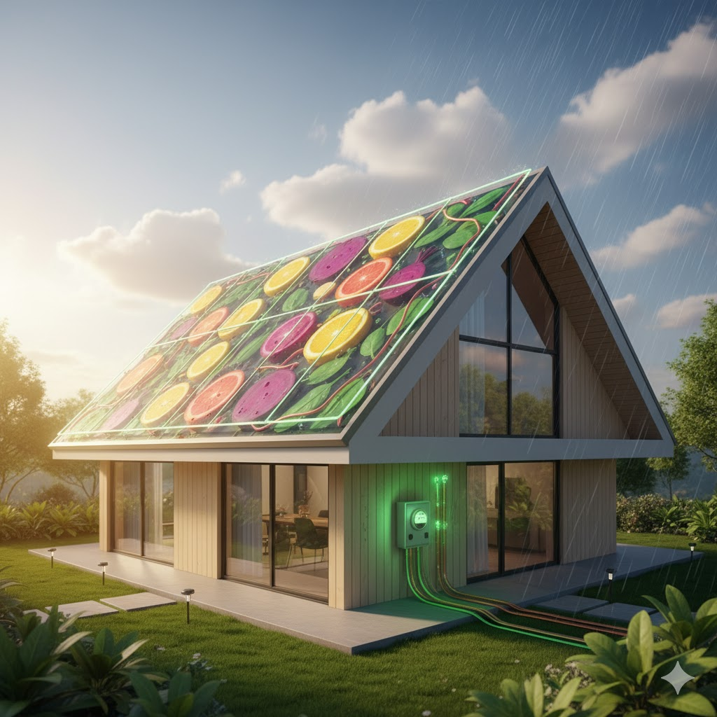
Project Overview - Introduction
Bio-Photovoltaic system that generates electricity using fruit juice electrolytes.
Replaces silicon with natural, biodegradable fruit-based energy.
Uses a weather API to suggest the best fruit electrolyte for any city.
Displays power output, efficiency, cost per hour, and fruit properties.
Features a smooth and futuristic 3D interactive user interface.
Notes:
Sustainability and AI
Sustainability is important because it helps meet our needs now and in the future. It includes protecting the environment, reducing pollution, and improving economic and social well-being.
AI can help us achieve sustainability. AI can process data, make predictions, and optimize systems to solve problems like resource management, environmental conservation, and energy efficiency.
Examples:
Smart grids: Reduce energy consumption.
Agriculture: Optimize water and fertilizer use.
Biodiversity: Monitor wildlife to protect biodiversity.
AI is a powerful tool for creating a more sustainable future.

Slide 6
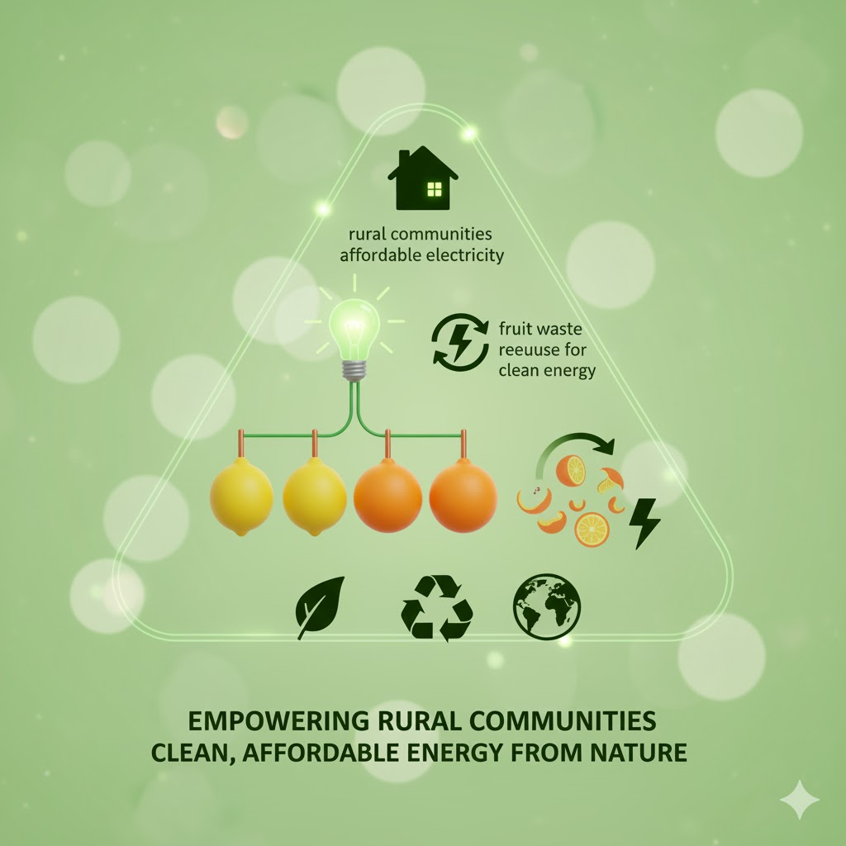
Motivation
Rising Need for Low-Cost Renewable Energy
Rural areas face costly or limited electricity; fruit-based systems offer an affordable alternative.
Using Natural & Easily Available Resources
Fruits are accessible, biodegradable, and safe—making them a simple micro-energy source.
Reducing Fruit Wastage
Spoiled or unused fruits can be repurposed into electricity instead of being wasted.
Eco-Friendly and Sustainable Solution
Fruit electrolytes have zero carbon footprint, supporting clean and green energy.
Encouraging Innovation in Green Energy
Combining biology + technology opens new possibilities for renewable energy innovation.

Slide 7
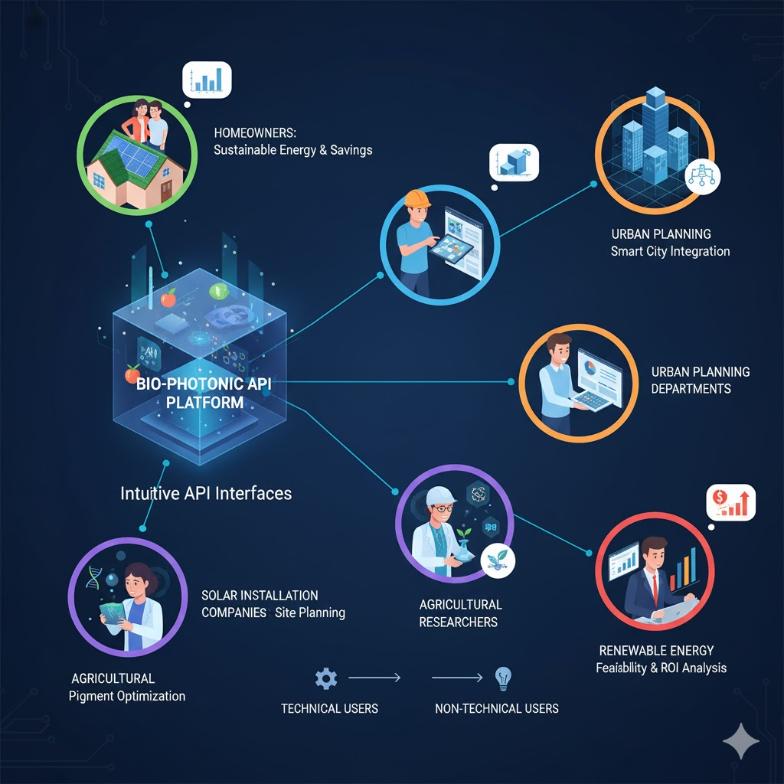
End Users
Rural & remote households needing low-cost power
Educational institutions (science labs & demos)
Disaster relief zones
Eco-friendly product developers
Renewable energy researchers & startups
Notes:
Sustainability and AI
Sustainability is important because it helps meet our needs now and in the future. It includes protecting the environment, reducing pollution, and improving economic and social well-being.
AI can help us achieve sustainability. AI can process data, make predictions, and optimize systems to solve problems like resource management, environmental conservation, and energy efficiency.
Examples:
Smart grids: Reduce energy consumption.
Agriculture: Optimize water and fertilizer use.
Biodiversity: Monitor wildlife to protect biodiversity.
AI is a powerful tool for creating a more sustainable future.

Slide 8
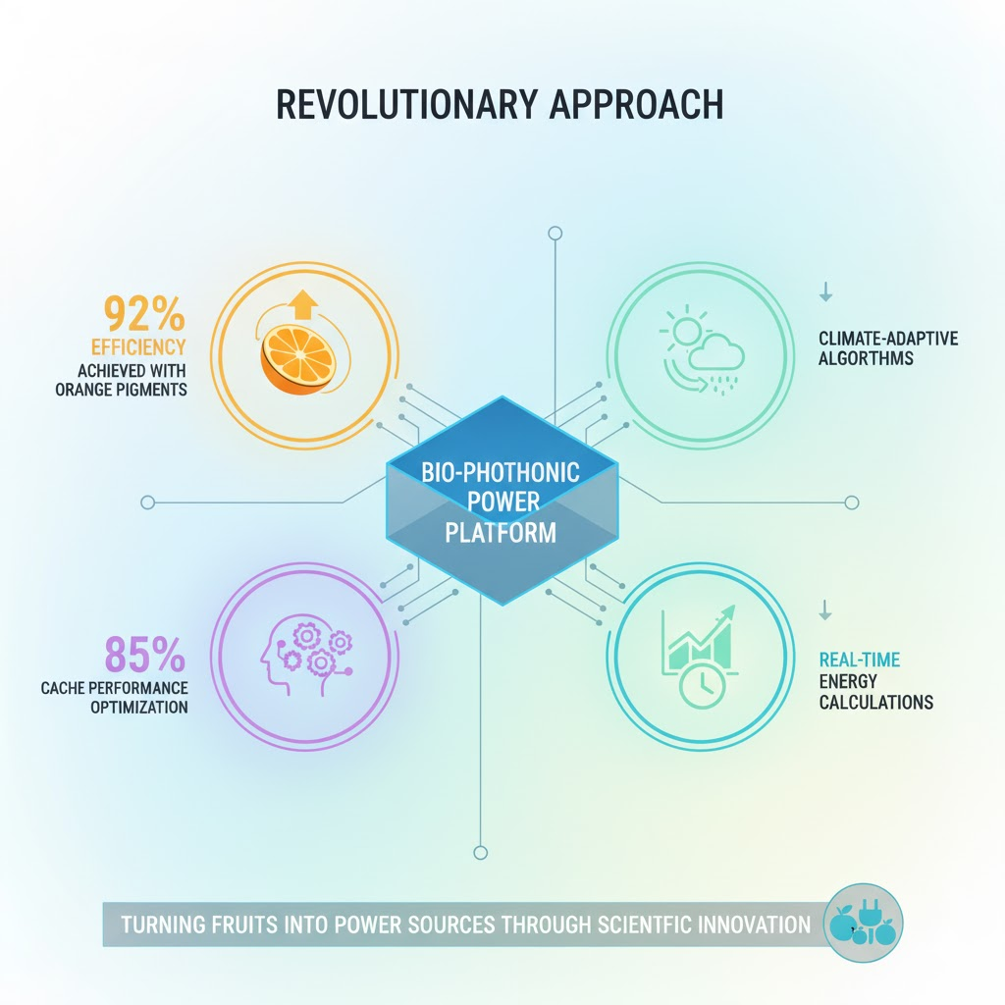
Wow Factors in Project
Best efficiency in sunny climates: Orange Juice – 95%
Best performance in cloudy conditions: Beetroot Juice – 90%
Overall cost reduction: Up to 60% cheaper than commercial solar panels
Return on investment (ROI): Achieved in 6–8 months
Eco-friendly materials: Fully biodegradable setup
Energy source: Uses fruit juice electrolytes
Technology fusion: Unique blend of biology + technology
Notes:
Sustainability and AI
Sustainability is important because it helps meet our needs now and in the future. It includes protecting the environment, reducing pollution, and improving economic and social well-being.
AI can help us achieve sustainability. AI can process data, make predictions, and optimize systems to solve problems like resource management, environmental conservation, and energy efficiency.
Examples:
Smart grids: Reduce energy consumption.
Agriculture: Optimize water and fertilizer use.
Biodiversity: Monitor wildlife to protect biodiversity.
AI is a powerful tool for creating a more sustainable future.

Slide 9
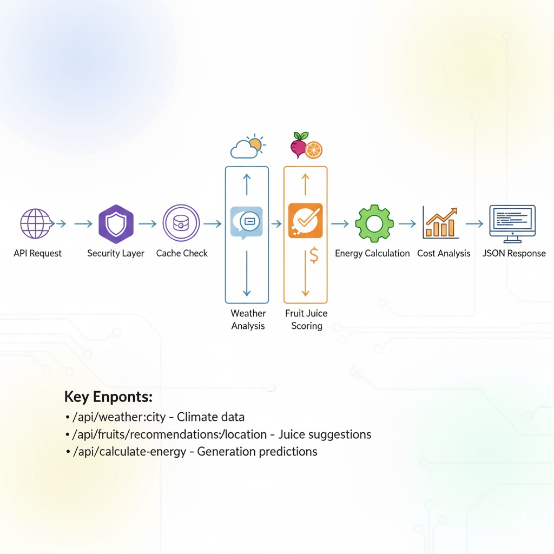
Modelling/Block Diagram/Flow of Project
End-to-end flow of how the system analyzes weather, selects the best fruit electrolyte, and calculates energy output
Notes:
Sustainability and AI
Sustainability is important because it helps meet our needs now and in the future. It includes protecting the environment, reducing pollution, and improving economic and social well-being.
AI can help us achieve sustainability. AI can process data, make predictions, and optimize systems to solve problems like resource management, environmental conservation, and energy efficiency.
Examples:
Smart grids: Reduce energy consumption.
Agriculture: Optimize water and fertilizer use.
Biodiversity: Monitor wildlife to protect biodiversity.
AI is a powerful tool for creating a more sustainable future.

Slide 10
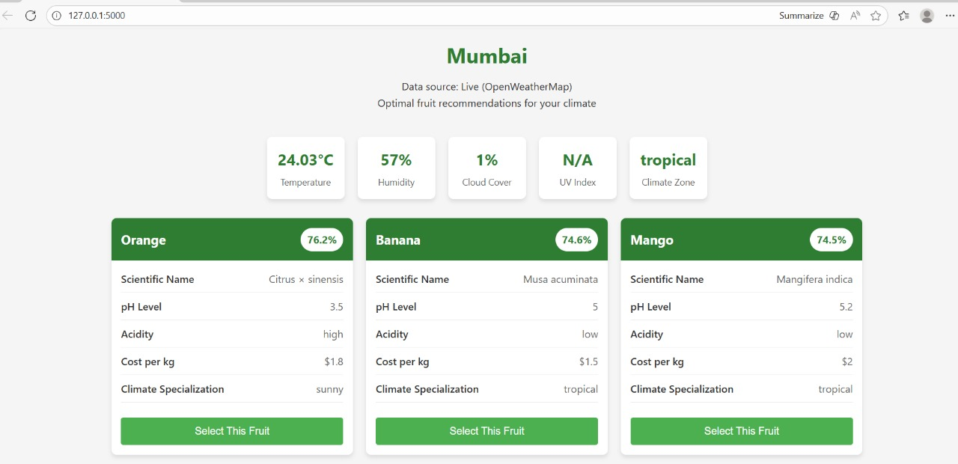
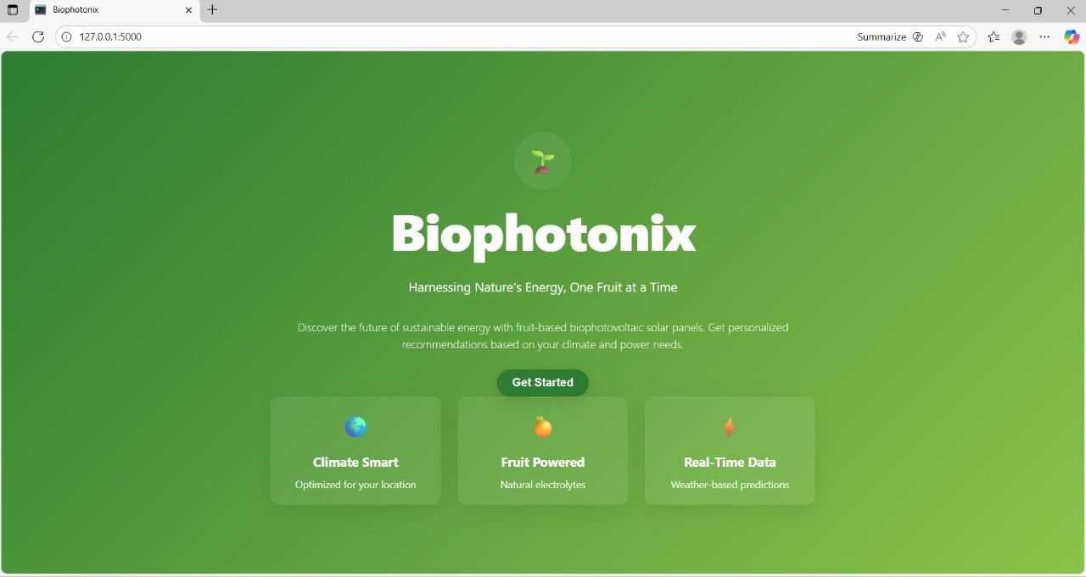

Result/Outcomes
Welcome/Home page
Recommendation page
Notes:
Sustainability and AI
Sustainability is important because it helps meet our needs now and in the future. It includes protecting the environment, reducing pollution, and improving economic and social well-being.
AI can help us achieve sustainability. AI can process data, make predictions, and optimize systems to solve problems like resource management, environmental conservation, and energy efficiency.
Examples:
Smart grids: Reduce energy consumption.
Agriculture: Optimize water and fertilizer use.
Biodiversity: Monitor wildlife to protect biodiversity.
AI is a powerful tool for creating a more sustainable future.

Slide 11


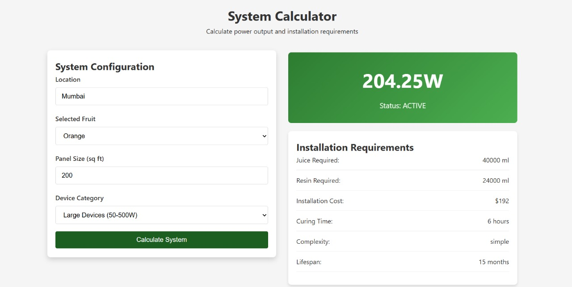

Slide 12
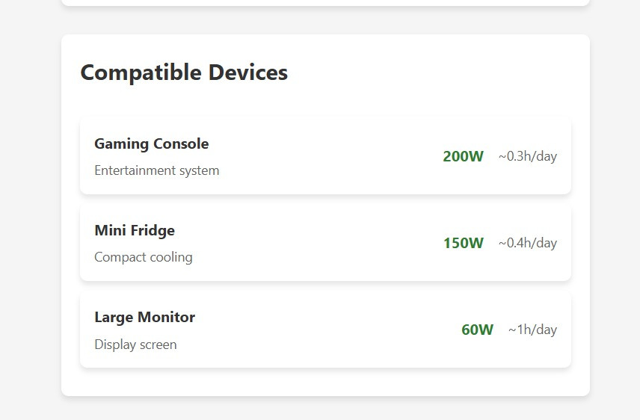

Slide 13
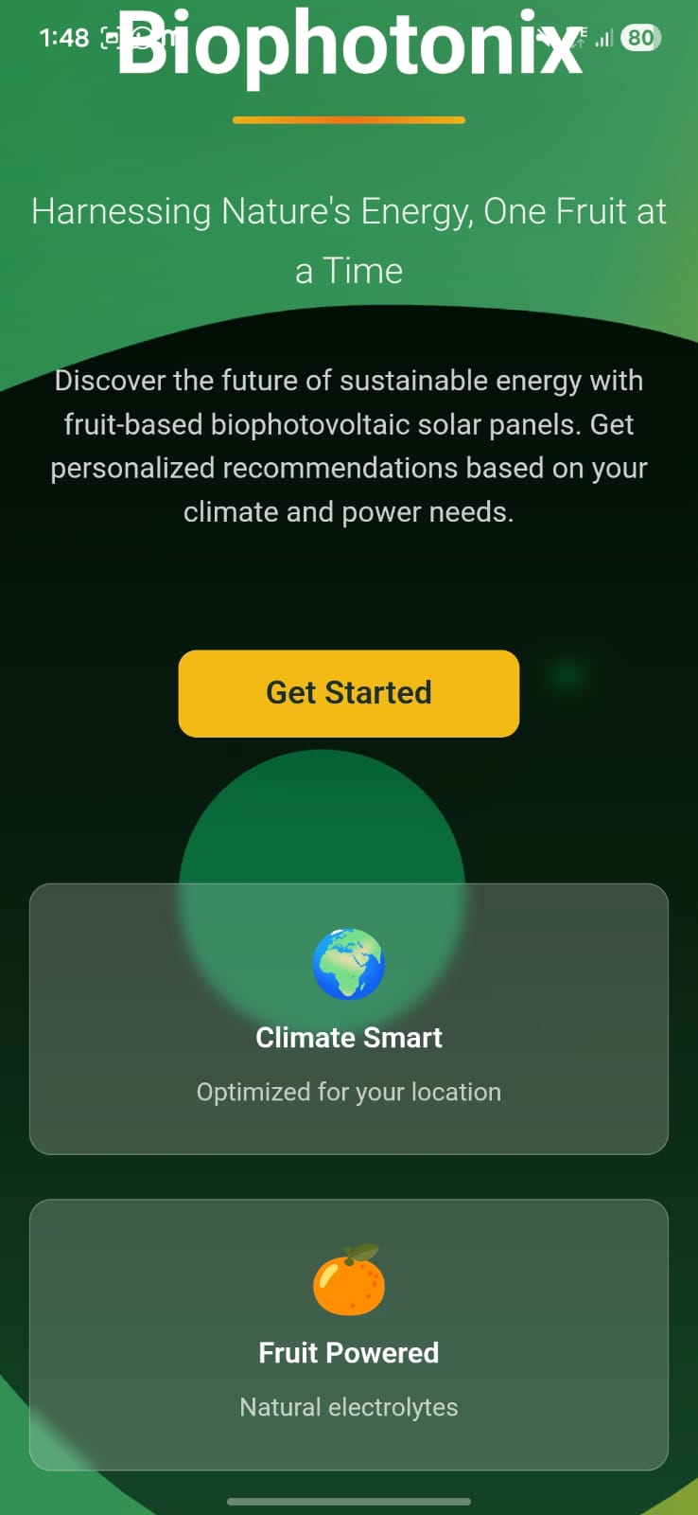
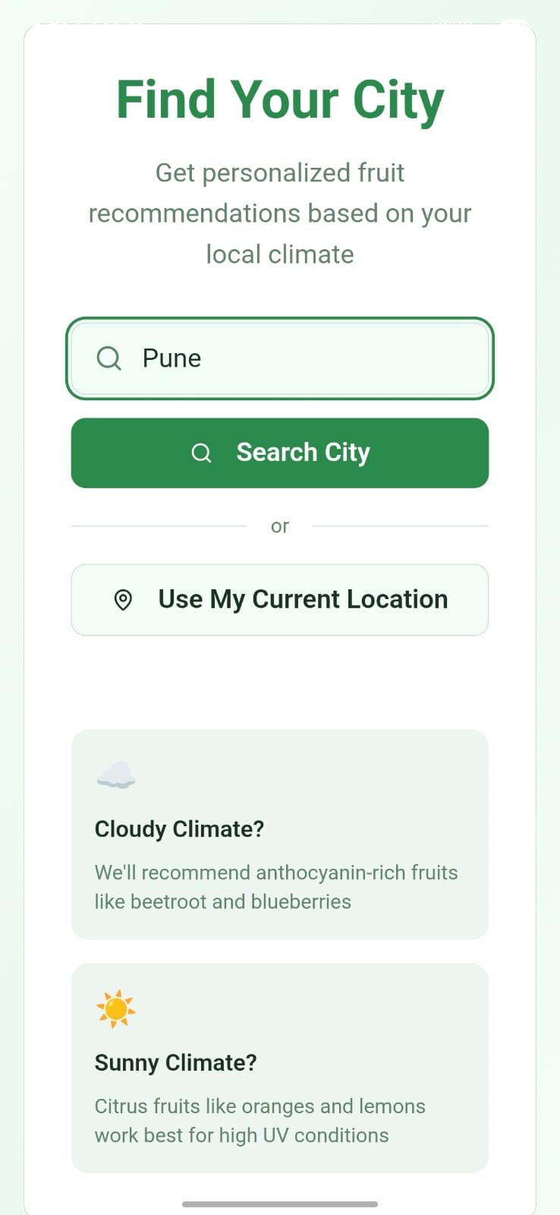
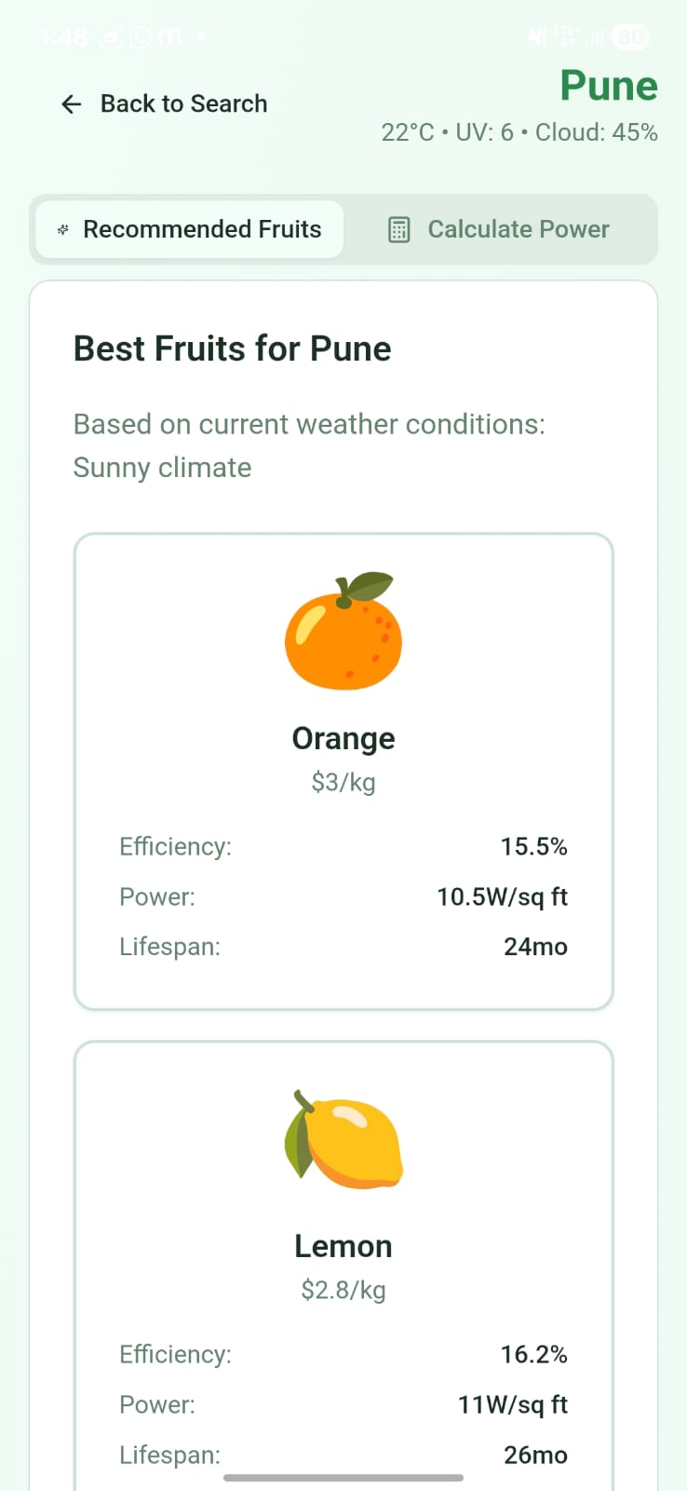
Result :- Mobile app View

Slide 14
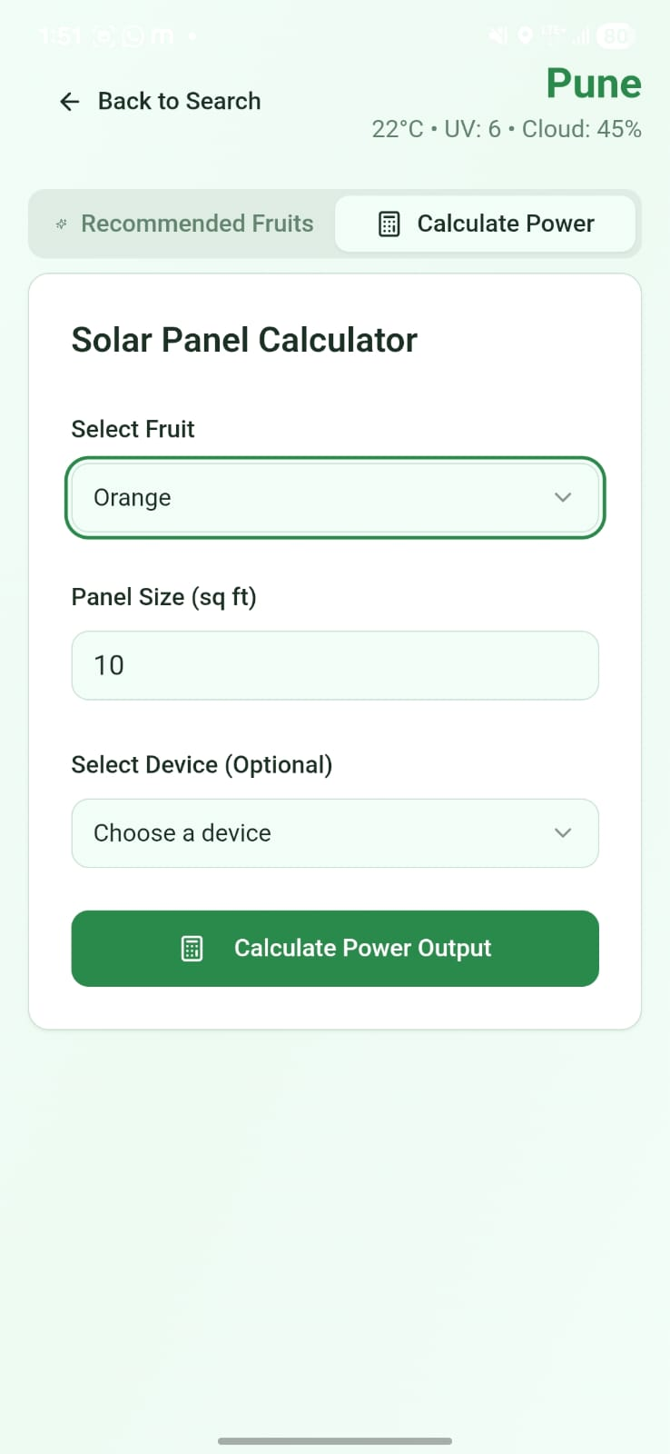
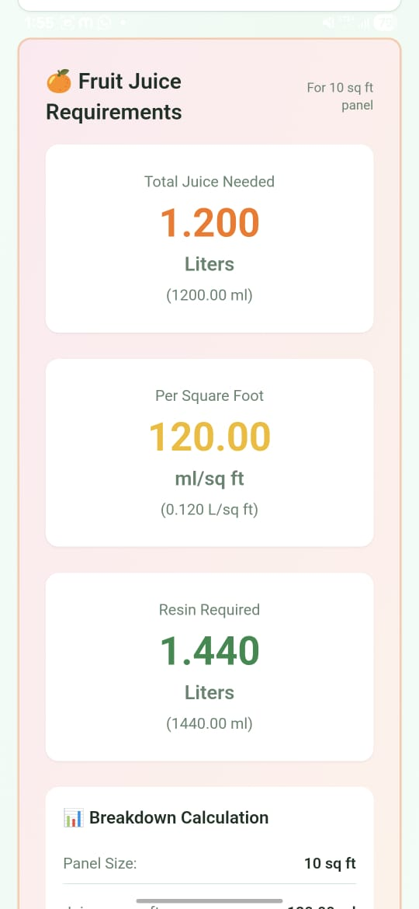
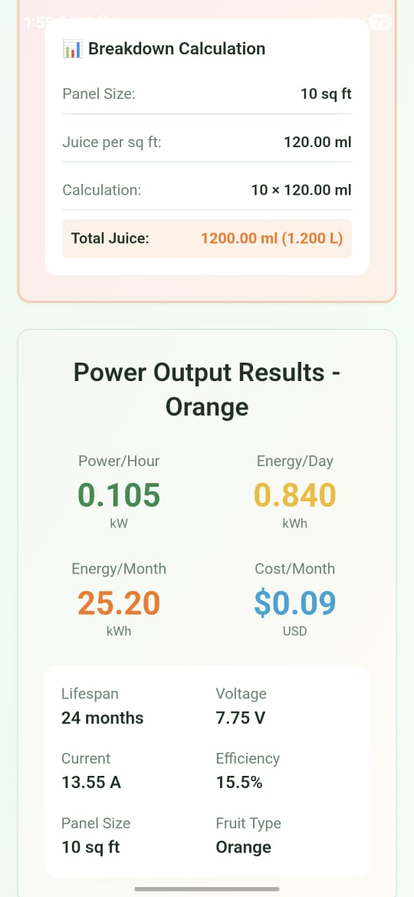

Slide 15
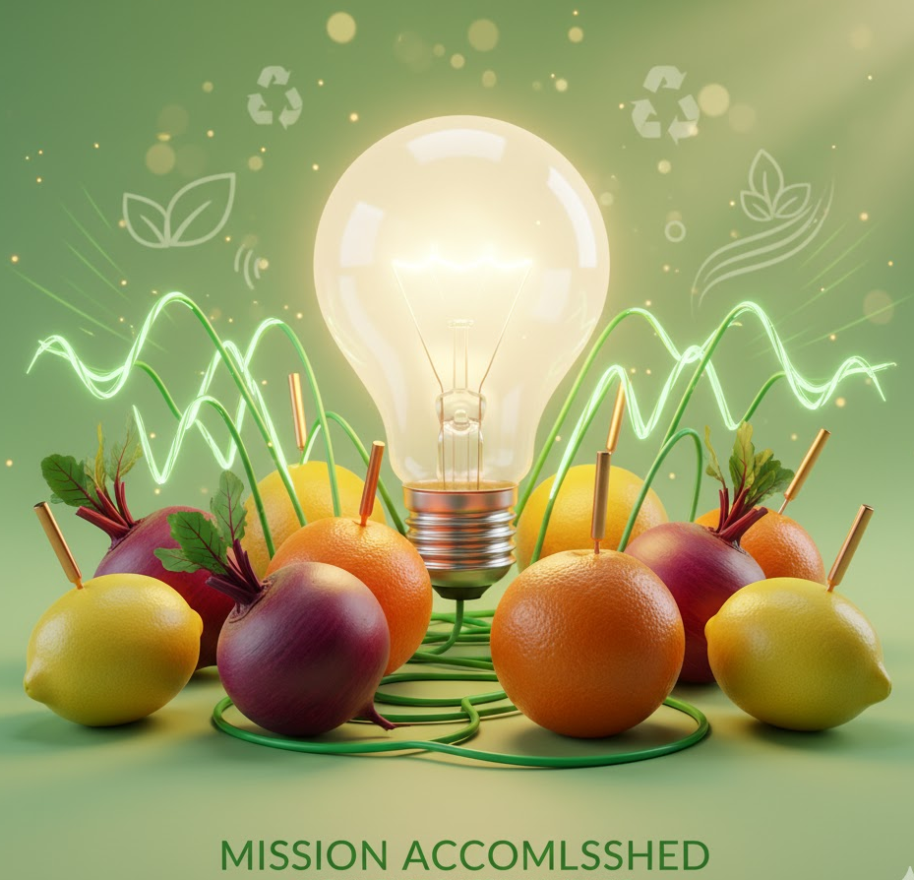
Conclusion
Fruit juice can act as a natural and eco-friendly source of electricity.
The project presents a simple and affordable alternative to silicon solar panels.
Weather-based fruit selection improves power efficiency and usability.
The system proves the potential of combining biology with modern technology.
This concept opens new possibilities for sustainable energy in rural areas
Notes:
Sustainability and AI
Sustainability is important because it helps meet our needs now and in the future. It includes protecting the environment, reducing pollution, and improving economic and social well-being.
AI can help us achieve sustainability. AI can process data, make predictions, and optimize systems to solve problems like resource management, environmental conservation, and energy efficiency.
Examples:
Smart grids: Reduce energy consumption.
Agriculture: Optimize water and fertilizer use.
Biodiversity: Monitor wildlife to protect biodiversity.
AI is a powerful tool for creating a more sustainable future.

Slide 16
Reference
References
OpenWeatherMap API Documentation https://openweathermap.org/api
Bio-photovoltaic Research Articles https://www.sciencedirect.com/topics/engineering/biophotovoltaic
Renewable Energy Concepts https://energy.gov/science-innovation
Electrochemical Cell Fundamentals https://chem.libretexts.org/Bookshelves/Physical_and_Theoretical_Chemistry
Project GitHub Repository
https://github.com/27Neha/bio_photovoltaic_system

Slide 17
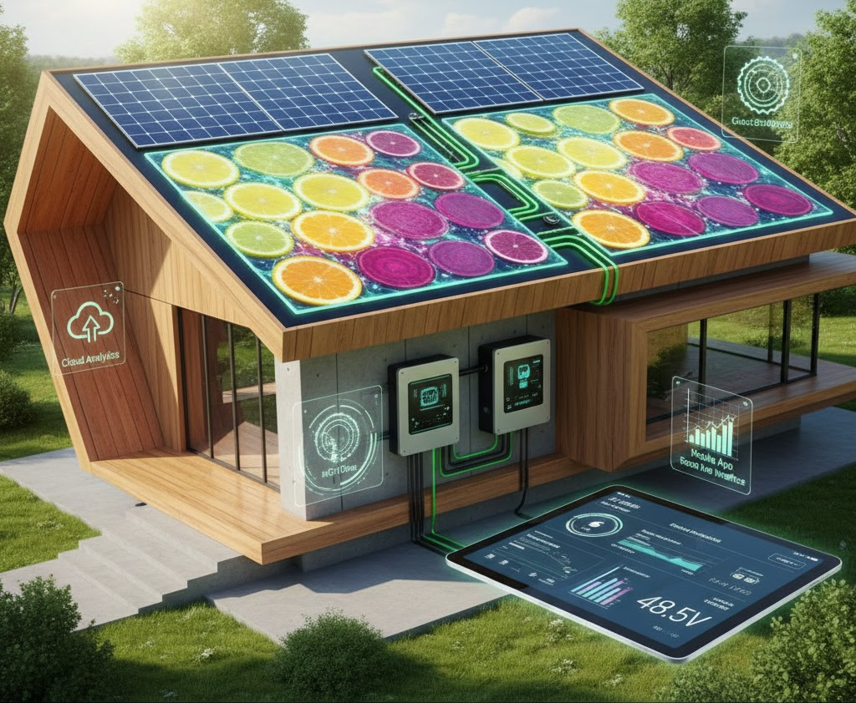
Future Perspective
Build a hybrid solar + bio-photovoltaic system
Add IoT sensors to monitor real-time voltage
Expand the fruit database using experimental lab testing
Deploy as a mobile app for global use
Create a physical prototype with replaceable electrolyte cartridges
Integrate cloud analytics for energy tracking
Notes:
Sustainability and AI
Sustainability is important because it helps meet our needs now and in the future. It includes protecting the environment, reducing pollution, and improving economic and social well-being.
AI can help us achieve sustainability. AI can process data, make predictions, and optimize systems to solve problems like resource management, environmental conservation, and energy efficiency.
Examples:
Smart grids: Reduce energy consumption.
Agriculture: Optimize water and fertilizer use.
Biodiversity: Monitor wildlife to protect biodiversity.
AI is a powerful tool for creating a more sustainable future.

Slide 18
Thank You
Notes:
Thank You !!

